Slide 1
Internet Routing
Esha Desai
USC ID: 6993245898

Slide 2
Background
Invention of protocols to automate the propagation of routing information (next hop information) and allow new sites to join the Internet and communicate instantly with other sites
Gateways work in store and forward manner
Gateway Protocols:
Vector Distance Protocols (count-to-infinity problem)
Link Status Protocols(less prone to loops)
IGP-Interior Gateway protocol(within autonomous systems)
EGP-Exterior Gateway Protocol (between autonomous systems)

Slide 3
Protocols
EGP- Isolates sites (i.e. AS’s)
- Distance Vector Protocol
- Reachability Protocol
IGP Protocols:
GGP-Gateway-Gateway Protocol (Extra hop problem)
RIP-Routing Information Protocol
HELLO
Butterfly Gateways
Extensions like split horizon, holddown, modified hop count etc. added to RIP to counter excessive increase in network diameter

Slide 4
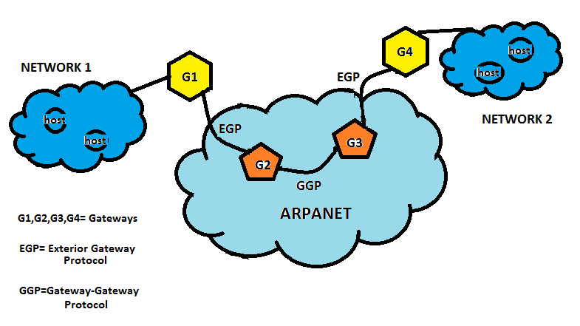
Internet Routing

Slide 5
Question
Has the Internet really ‘succeeded’ by introducing the routing protocols?
Reachability is NOT the only goal for gateways. Routing should be efficient, adaptive & cost-effective.
Top levels of hierarchy should function independently of lower levels
A well defined “hierarchical” topology needed to adapt to future changes in needs like increase in demand or changes of services
For improved performance a universally accepted EGP protocol supported by all AS border gateways.

